Slide 1
Motivation
Who Cares?
Nuclear Engineers
Design of fault-tolerant fuels
Understanding accident scenarios
Civil Engineers
Measuring global warming potential of water treatment plants
Understanding cost-benefit analysis of hybrid energy systems

Slide 2
Motivation
Who Cares?
Anyone looking to do:
Sensitivity analysis
Optimization
Data fitting
Trade-off analysis
Projection/Interpolation/Extrapolation
Validation and Verification

Slide 3
Challenges
We want the most out of the least amount of information since data is hard to come by:
Expensive
Time-consuming
Dangerous
Data can exist in high-dimensional spaces which has a few problems:
Exponential increase of volume as dimension increases
Lack of intuition or ability to visualize
Looking for compact summary of data that maintains structure of the data
Topology

Slide 4
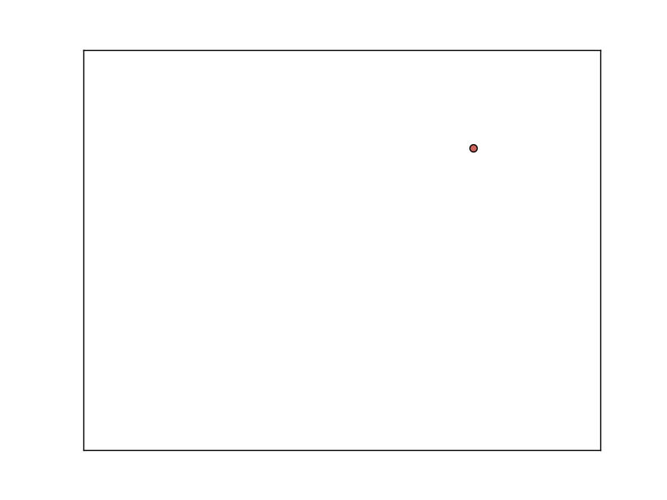
Background: Topology
Contour Tree

Slide 5
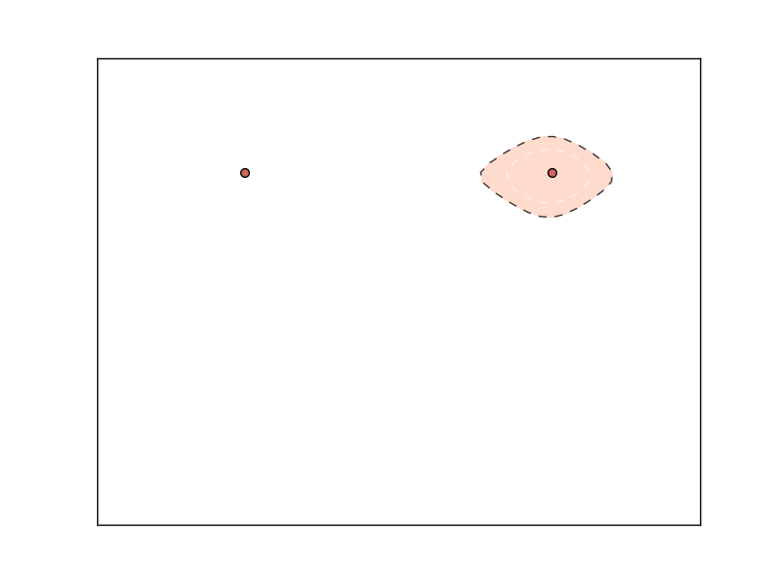
Background: Topology
Contour Tree

Slide 6
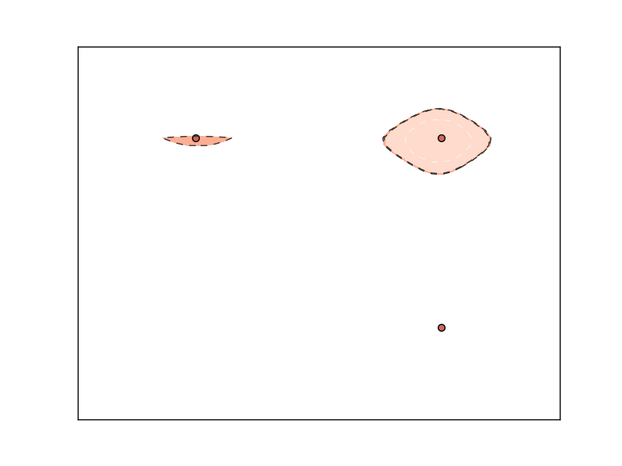
Background: Topology
Contour Tree

Slide 7
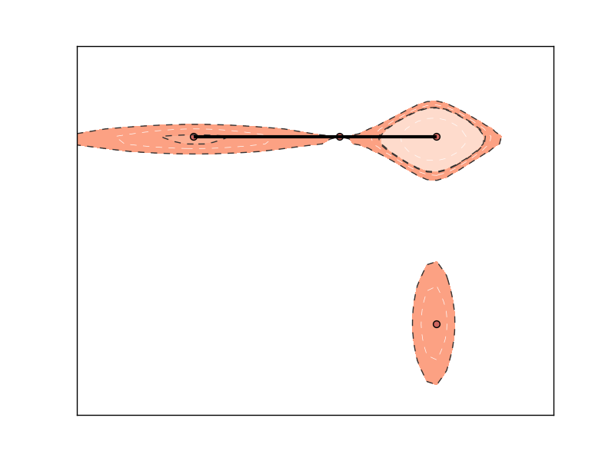
Background: Topology
Contour Tree
2
1
2
1

Slide 8
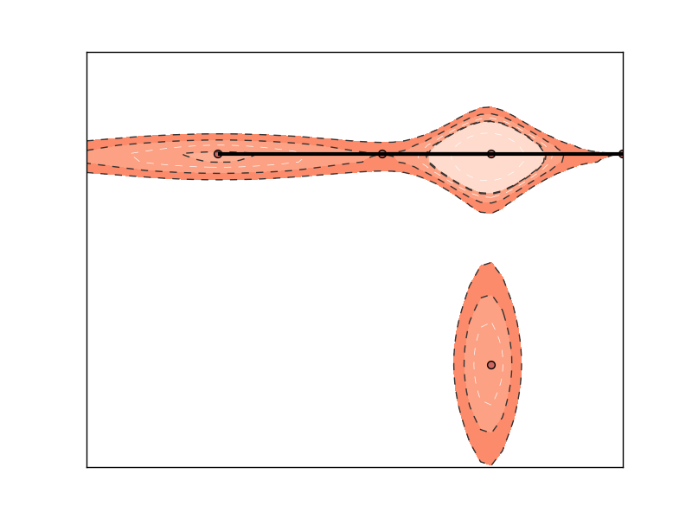
Background: Topology
Contour Tree

Slide 9
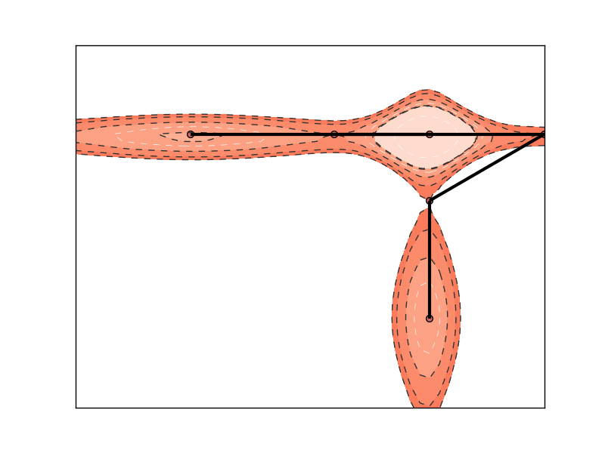
Background: Topology
Contour Tree
2
1
1
2

Slide 10
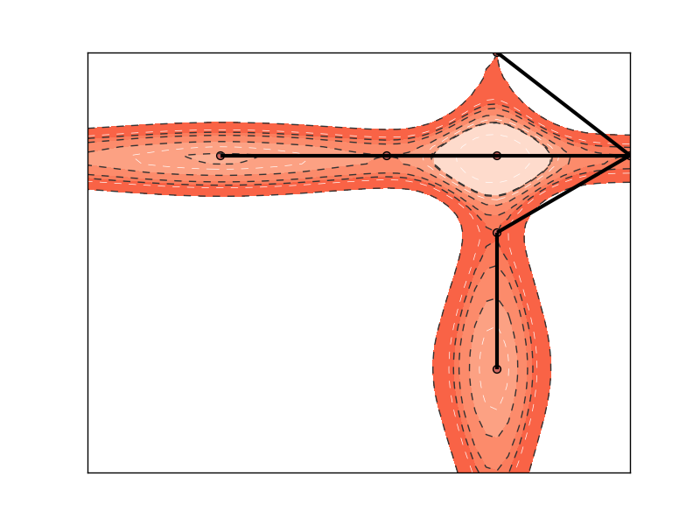
Background: Topology
Contour Tree
3
4
2
3
4
1
2
1

Slide 11
Background: Topology
Contour Tree
3
4
1
2
3
4
1
2
f(x)

Slide 12
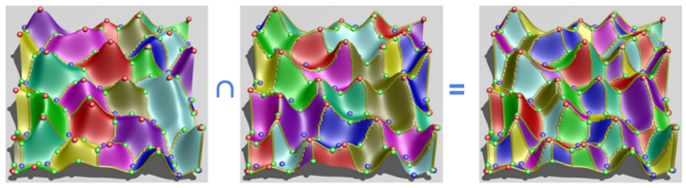
Background: Topology
Morse-Smale Complex
Stable/Descending
Manifolds
Unstable/Ascending
Manifolds
Morse-Smale
Complex

Slide 13


Background: Topology
Morse-Smale Complex
Stable/Descending
Manifolds
Unstable/Ascending
Manifolds
Morse-Smale
Complex

Slide 14
Background: Topology
Persistence Simplification
Critical Points:
maxima =
minima =
p_{c}
p_{a}
p_{b}
b
c
a

Slide 15
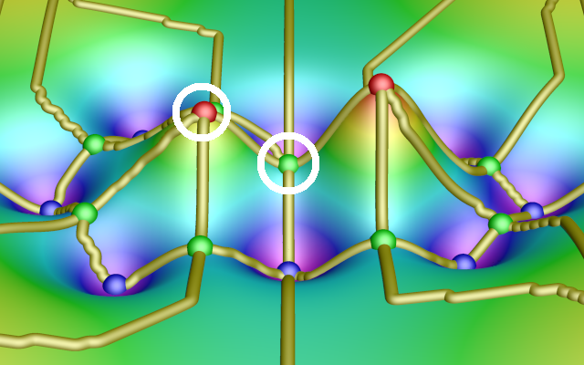
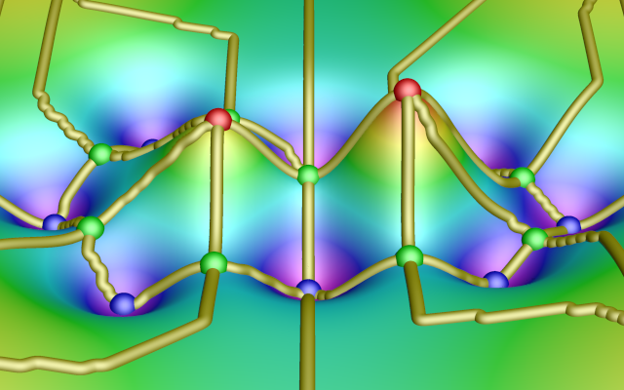
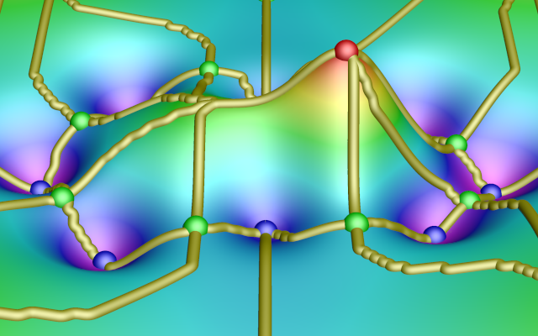



Background: Topology
Persistence Simplification
Local Maximum
Saddle
Local Minimum

Slide 16
Background: Topology
Persistence Simplification
Local Maximum
Saddle
Local Minimum

Slide 17
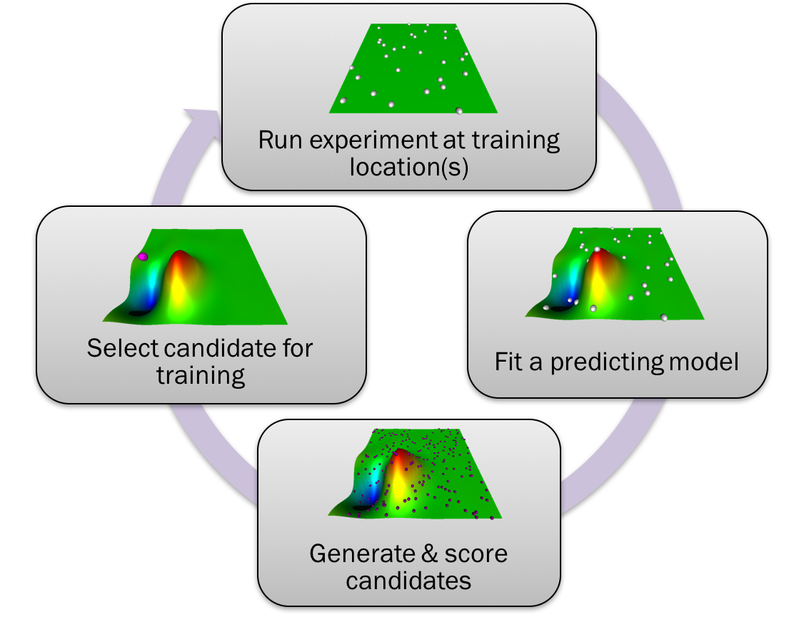

Slide 18
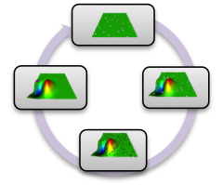
Explore: Candidate Generation
Global pool based on a space-filling design

Slide 19
Explore: Candidate Generation
Global pool based on a space-filling design
Can be specific to the problem
e.g., a set of points from a previously extracted limit surface

Slide 20
Explore: Candidate Generation
Global pool based on a space-filling design
Can be specific to the problem
e.g., a set of points from a previously extracted limit surface

Slide 21
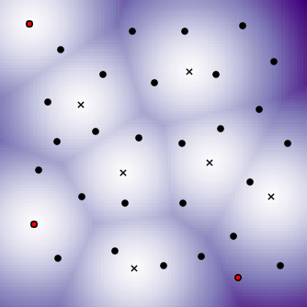
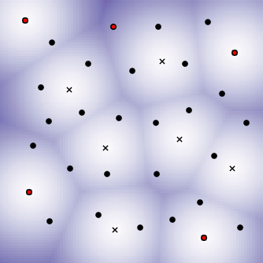
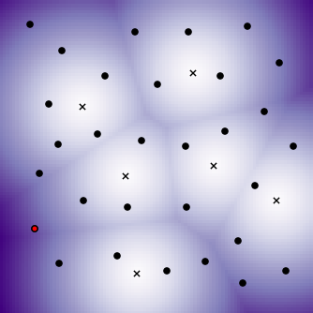
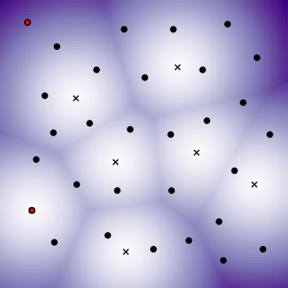
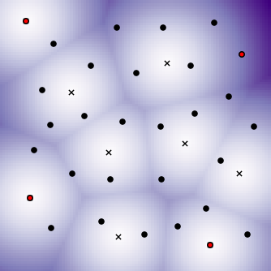
Explore: State of the Art
Candidate generation
Scoring methods (Global setting)
Low sampling density
low score
high score

Slide 22
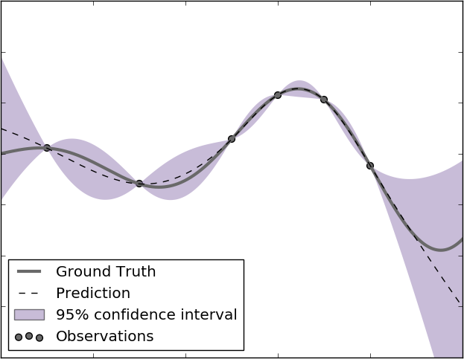
Explore: State of the Art
Candidate generation
Scoring methods (Global setting)
Low sampling density
High uncertainty in the current predicting model

Slide 23
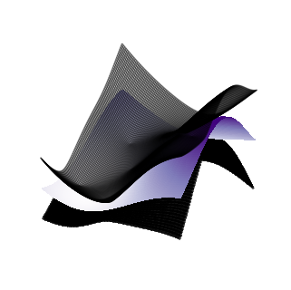
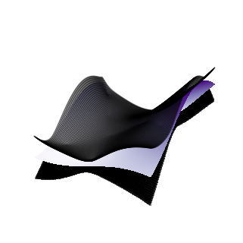
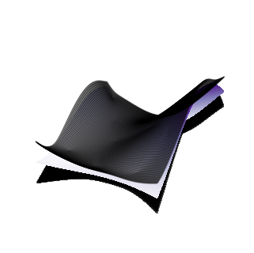
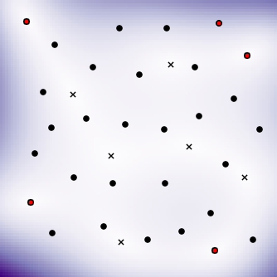
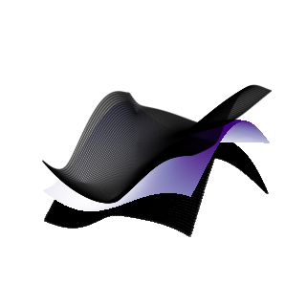
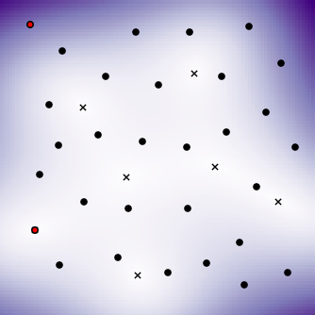
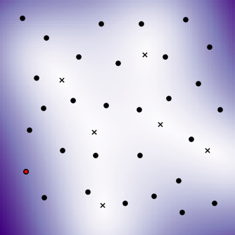
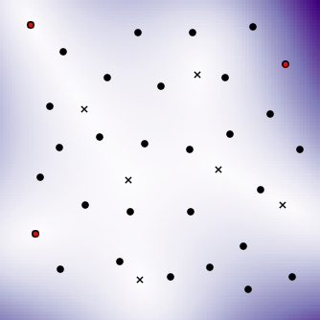
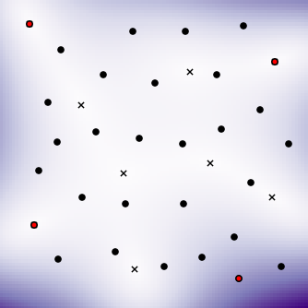
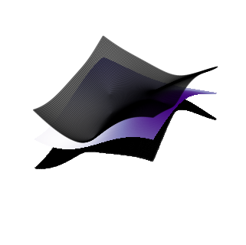
Explore: State of the Art
Candidate generation
Scoring methods (Global setting)
Low sampling density
High uncertainty in the current predicting model
low score
high score

Slide 24
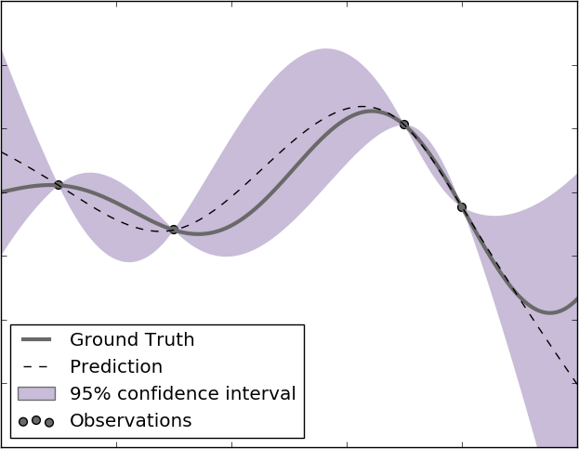
Explore: State of the Art
Candidate generation
Scoring methods (Global setting)
Low sampling density
High uncertainty in the current predicting model
Expected improvement
E(I(x)) = (Δy)² + σ²
σ²
Δy

Slide 25
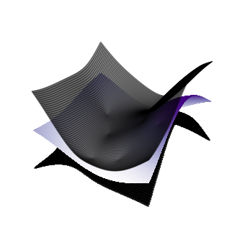
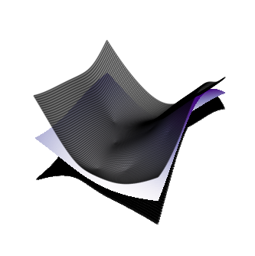

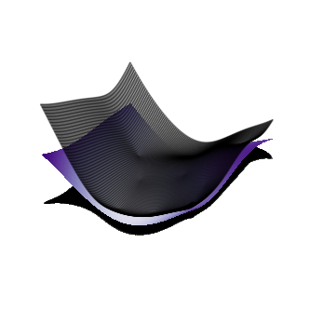
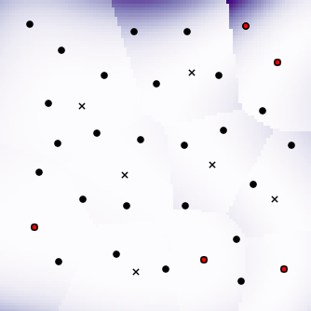
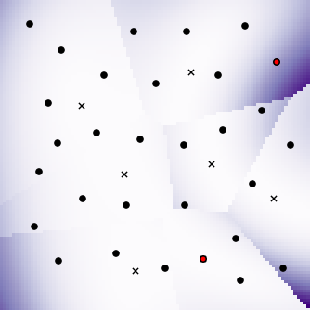
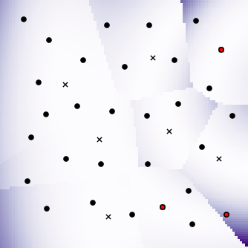
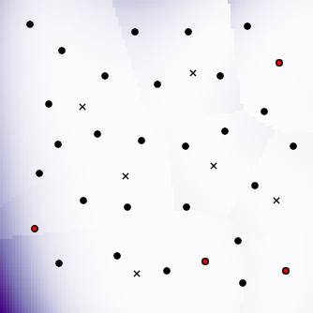
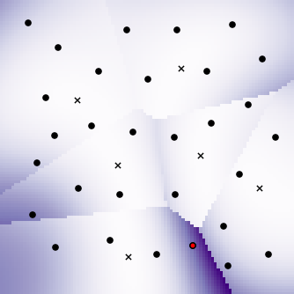
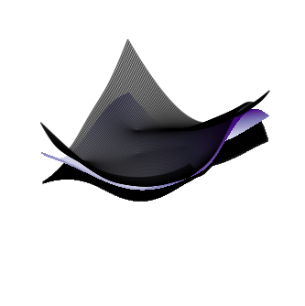
Explore: State of the Art
Candidate generation
Scoring methods (Global setting)
Low sampling density
High uncertainty in the current predicting model
Expected improvement
low score
high score

Slide 26
Explore: State of the Art
Candidate generation
Scoring methods (Global setting)
Low sampling density
High uncertainty in the current predicting model
Expected improvement
Topology-based scoring
low score
high score
Detect topologically significant changes

Slide 27
Explore: State of the Art
Candidate generation
Scoring methods (limit surface setting)
EI, Straddle, Ambiguity – target values near threshold or with high uncertainty
e.g.: S(x) = 1.96σ - |Δy|
σ²
Δy

Slide 28
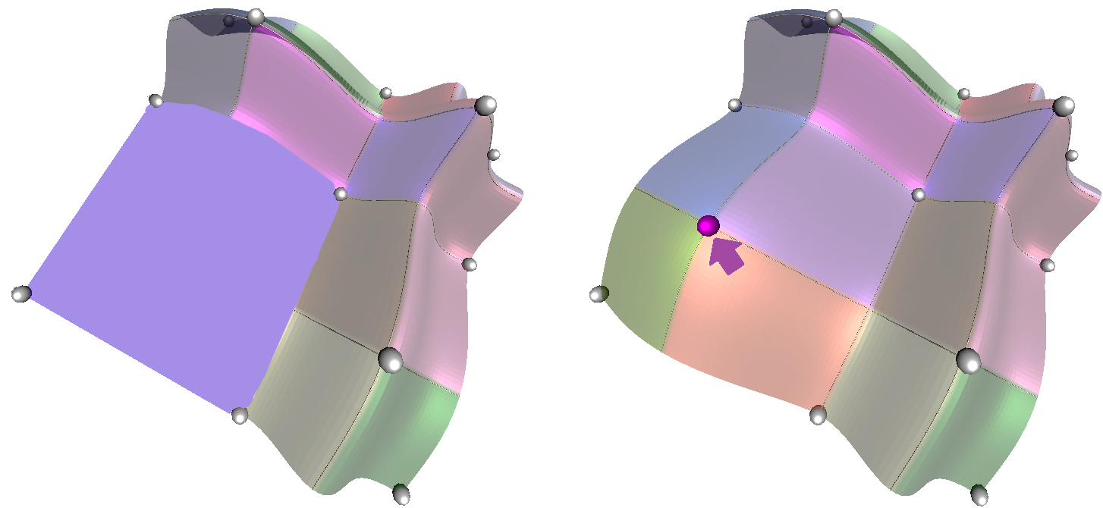
Explore: Proposed Solution
Average Change in Persistence
Average change in persistence (p) of each point computed by comparing the Morse-Smale before and after inserting a candidate

Slide 29
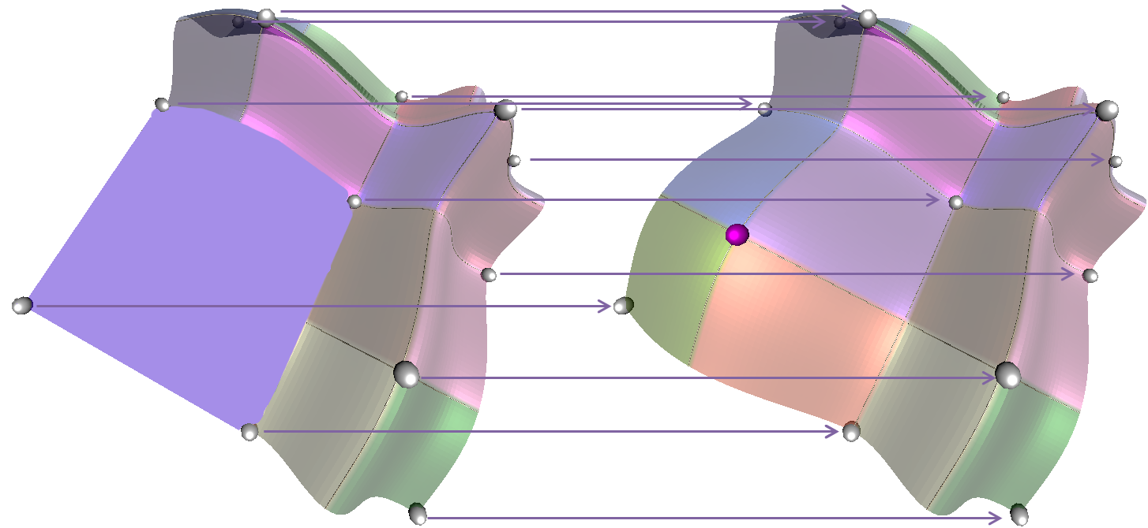
Explore: Proposed Solution
Average Change in Persistence
Average change in persistence (p) of each point computed by comparing the Morse-Smale before and after inserting a candidate
Σ(Δp)/n

Slide 30
Explore: Proposed Solution
Bottleneck Distance in Persistence
Bottleneck distance between persistence diagram of Morse-Smale before and after inserting a candidate point
y
death
x
birth

Slide 31
Explore: Proposed Solution
Bottleneck Distance in Persistence
Bottleneck distance between persistence diagram of Morse-Smale before and after inserting a candidate point
y
death
x
birth
Notes:
Optimization: minimize the distance between pairs of points in the two plots including the line y=x in both pairs
Bottleneck distance – the maximum distance resulting from this pairing

Slide 32
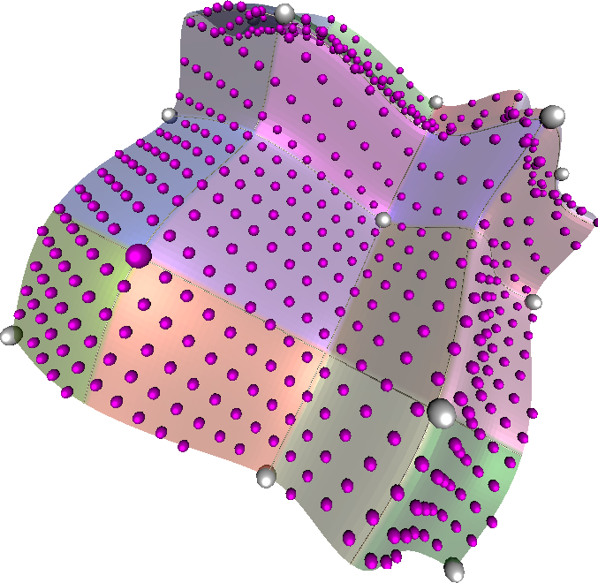
Explore: Proposed Solution
Highest Persistence
Find highest persistence critical point in Morse-Smale complex constructed from combined training and predicted candidate data

Slide 33
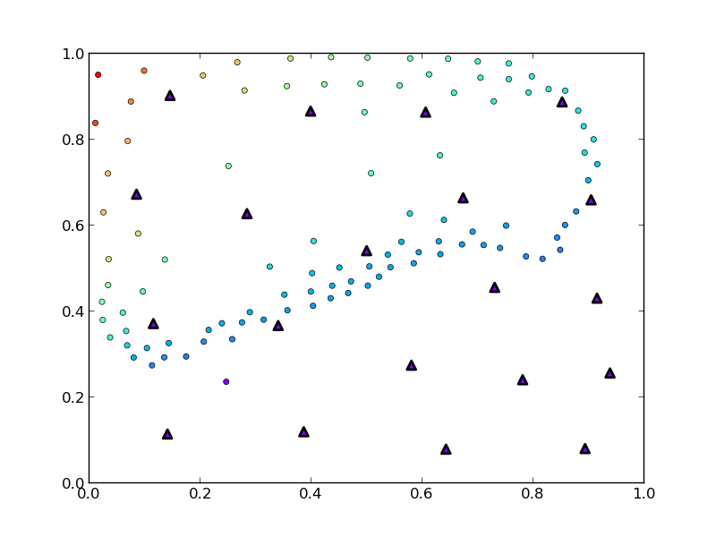
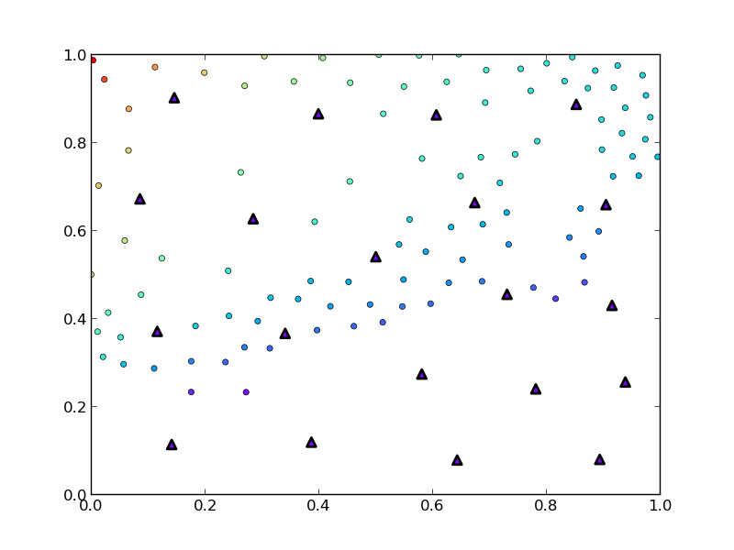
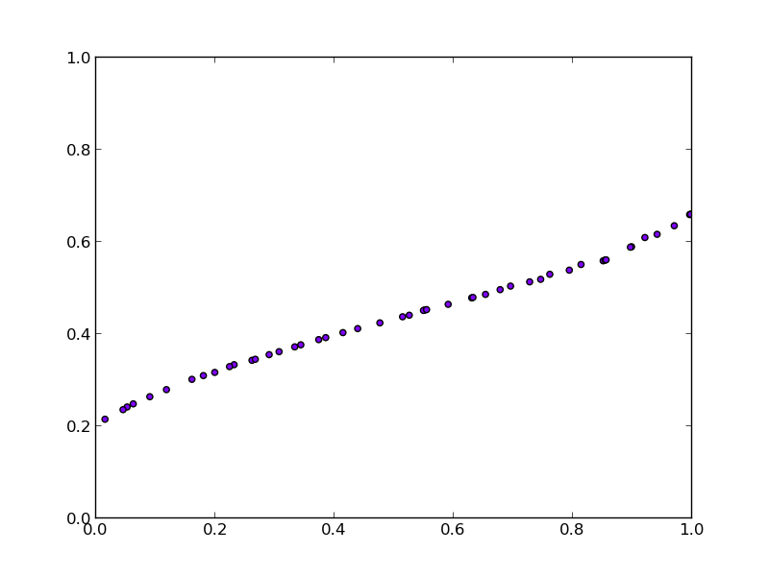
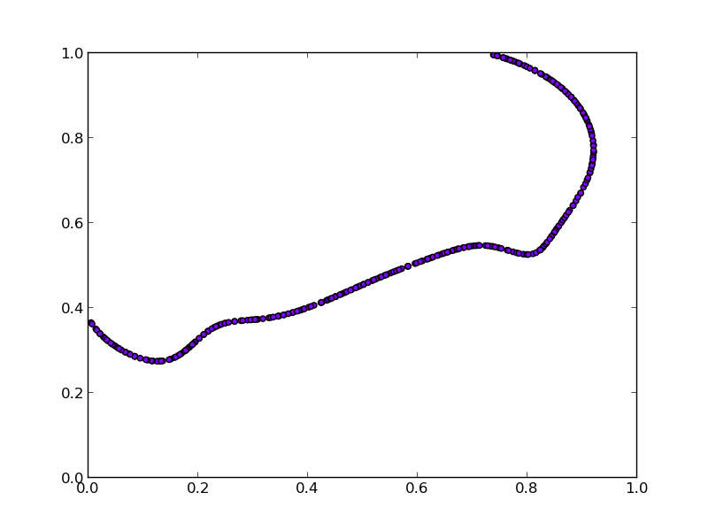
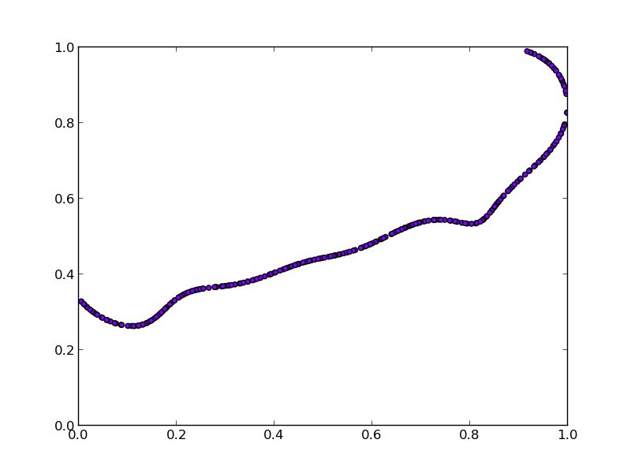
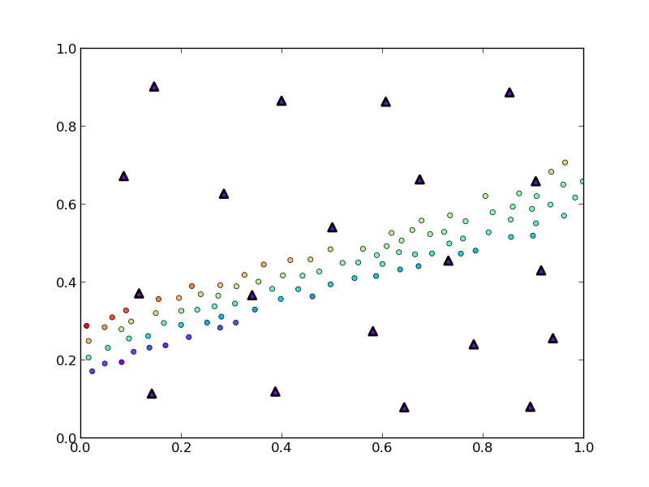
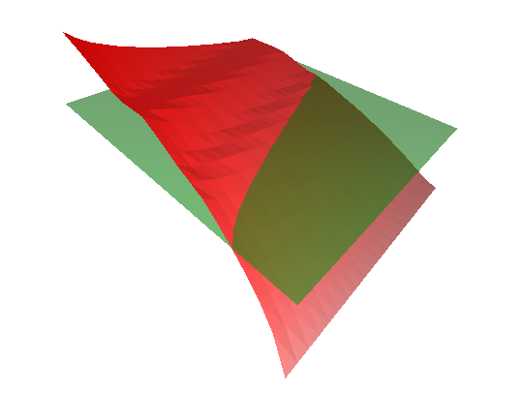
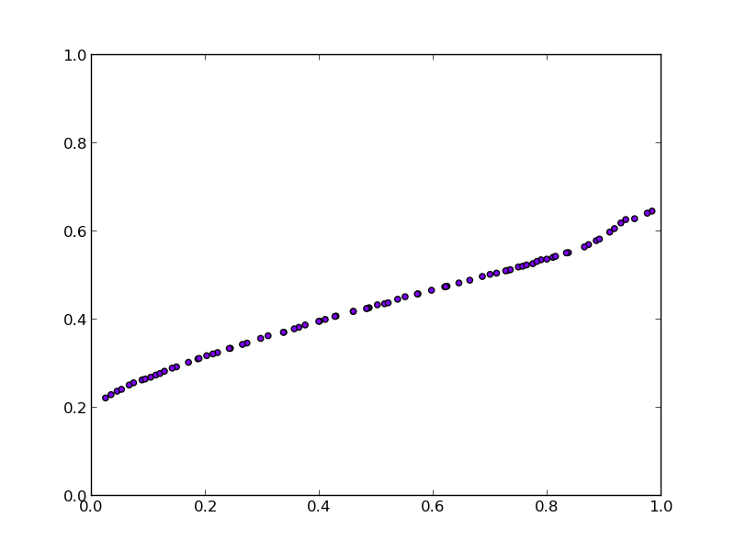
Explore: Limit Surface Adaptive Sampling
Model bias
M1
M2
M3
True Limit Surface

Slide 34
Explore: State of the Art
Candidate generation
Scoring methods (limit surface setting)
EI, Straddle, Ambiguity – target values near threshold or with high uncertainty
e.g.: S(x) = 1.96σ - |Δy|
σ²
Δy

Slide 35




Explore: Limit Surface Sampling: M1
Select training data & obtain true response
Score candidates & select candidate to add to the Training data
Fit a GPM
Select candidates by linearly interpolating spanning edges
Densely sample GPM & build neighborhood graph

Slide 36



Explore: Limit Surface Sampling: M3
Select training data & obtain true response
Score candidates & select candidate to add to the training data
Construct a neighborhood graph on the training data
Select candidates by linearly interpolating spanning edges (with added perturbations)

Slide 37


Explore: Candidate Selection
Candidate selection
One-at-a-time
Batch selection
allows running several time-consuming experiments in parallel
high score
low score

Slide 38

Explore: Proposed Solution
Candidate generation
Scoring methods
Candidate selection
One-at-a-time
Batch selection
allows running several time-consuming experiments in parallel
Identify distinct “peaks” in the data
high score
low score

Slide 39
Analyze: Sensitivity Analysis (SA)
Study how experimental factors (inputs) affect response values (outputs)
Global SA
Compute summary metrics over entire data
What are the most important overall drivers?
First step for further exploration
Local SA
Compute partial derivatives per location
Spot checking and focused analysis on region of interest
Structured SA
Partition data, then analyze
Handles non-monotonic data
Provides per partition summary
What lies between?

Slide 40

Analyze: Problem Statement
Linear fit the data to understand which parameter is most sensitive
df/dx = ?
df/dy = ?
A global fit can fail to capture non-monotonic behavior.

Slide 41
Analyze: State of the Art

Slide 42
Analyze: Partition-Based Regression
CART (Classification and Regression Trees - Breiman et. al. 1984)
Partition domain recursively and fit data locally
How do you split the domain?
Minimizing Error
CART (Breiman et al. 1984)
Treed Regression (Alexander and Grimshaw, 1996)
SUPPORT (Chaudhuri et al., 1994)
BART (Chipman et al., 2000)
Analyze geometry
PHD (Li et al., 2000)
Morse-Smale Regression (Gerber et al., 2011)

Slide 43
Analyze: Partition-Based Regression
CART (Classification and Regression Trees - Breiman et. al. 1984)
Partition domain recursively and fit data locally
How do you split the domain?
What kind of models do you use to fit?
Minimizing Error
CART (Breiman et al. 1984)
Treed Regression (Alexander and Grimshaw, 1996)
SUPPORT (Chaudhuri et al., 1994)
BART (Chipman et al., 2000)
Analyze geometry
PHD (Li et al., 2000)
Morse-Smale Regression (Gerber et al., 2011)
Piecewise constant
CART (Breiman et al. 1984)
Piecewise linear
Treed Regression (Alexander and Grimshaw, 1996)
Low-order Splines
MARS (Friedman, 1991)
Piecewise polynomials
SUPPORT (Chaudhuri et al., 1994)

Slide 44

Analyze: State of the Art
cut
residual from linear regression
1st principal Hessian direction

Slide 45

Analyze: Proposed Solution
Sensitivity coefficients:
Linear
Pearson
Spearman rank
Stepwise Fitness:
Coefficient of determination (R²)

Slide 46




Analyze: Proposed Solution
stress
thermal expansion coefficient
power scaling factor

Slide 47


Analyze: Morse-Smale Approximation Errors
Recall the Morse-Smale Complex:
What if we do not have a smooth representation?

Slide 48
Analyze: State of the Art
Recall the Morse-Smale Complex:
What if we do not have a smooth representation?

Slide 49
REDO
Morse-Smale Regression - First introduced in Gerber et al. 2012
Contribution:
Emphasis on sensitivity analysis for summarizing data not prediction accuracy.
Generalized MSR to use standard global sensitivity metrics
Intuitive design as the result of feedback from nuclear scientists

Slide 50

Analyze: Proposed Solution
Underconnected graph
Overconnected graph

Slide 51











Analyze: Proposed Solution
β=1/√2
Gabriel Graph (GG)
β=√2
Relative Neighbor (RN)
Increasing Edge Density
Relaxed β=1/√2
Relaxed GG
Relaxed β=√2
Relaxed RN
Delaunay
kNN (k=4)
True Segmentation
Too many edges, means we miss the existence of a real segment
Too few edges, means lots of spurious segments

Slide 52














Analyze: Proposed Solution
Topology allows us to extract structure from high-dimensional data
R² < 0.001

Slide 53
Analyze: Proposed Solution
Topology allows us to extract structure from high-dimensional data
R² < 0.001

Slide 54
Analyze
~17,000 simulations
3 input parameters:
power_scalef = Power scaling factor of the core
grainradius_scalef = Scaling factor of the grain size in the fuel microstructure
thermal_expansion = Thermal expansion coefficient of the fuel
Response value: Midplane Von Mises stress
Goal: Creating fault tolerant fuels

Slide 55


Analyze
Contact Point
Equilibrium Point

Slide 56



Qualitative
Confusing

Slide 57

Analyze
Simplified map of the topology
Visual priority based on function of identifying correct scale:
Persistence scale
Function value of extrema
Number of samples flowing to/from extrema
Connectivity of extrema
Size = # of associated samples
Morse-Smale crystal’s color is consistent throughout UI
Maxima tend towards top
Qualitative
F(x)
Minima tend towards bottom
persistence

Slide 58




Analyze
Simplified map of the topology
Sensitivity Information
Linear Coefficients – Comparatively measure dimensions contribution to output
Pearson Correlation Coefficients – Measure scale-invariant linearity [-1,1]
Spearman Rank Correlation Coefficients – Measure scale-invariant monotonicity [-1,1]

Slide 59
Analyze
Motivates us to provide a more interactive experience and to quantify these errors so that users can avoid them and we can move towards automatically detecting problem areas.

Slide 60
Analyze: SA Results for Nuclear Fuel
Contact Point
stress
Equilibrium Point
thermal expansion coefficient
Rethinking Sensitivity Analysis of Nuclear Simulations with Topology. Dan Maljovec, Bei Wang, Paul Rosen, Andrea Alfonsi, Giovanni Pastore, Cristian Rabiti, and Valerio Pascucci. Proceedings of IEEE Pacific Visualization (PacificVis), 2016.
Available in the RAVEN software at INL
power scaling factor

Slide 61
Timeline
2013
2014
2015
2016
2017
Explore
Explore
Explore
Analyze
Analyze
Synthesize
Adaptive Sampling with Topological Scores. Dan Maljovec, Bei Wang, Ana Kupresanin, Gardar Johannesson, Valerio Pascucci, and Peer-Timo Bremer. International Journal for Uncertainty Quantification, 3(2), pages 119-141, 2013.

Slide 62

Timeline
2013
2014
2015
2016
2017
Explore
Explore
Explore
Analyze
Analyze
Synthesize
Adaptive Sampling Algorithms for Probabilistic Risk Assessment of Nuclear Simulations. Dan Maljovec, Bei Wang, Diego Mandelli, Peer-Timo Bremer, and Valerio Pascucci. International Topical Meeting on Probabilistic Safety Assessment and Analysis (PSA), 2013.
*Runner-up for Best Student Paper Award

Slide 63
Timeline
2013
2014
2015
2016
2017
Explore
Explore
Explore
Analyze
Analyze
Synthesize
Topology-Based Active Learning. Dan Maljovec, Bei Wang, John Moeller, and Valerio Pascucci. SCI Technical Report UUSCI-2014-00, 2014.
*Available in the RAVEN software at INL

Slide 64
Timeline
2013
2014
2015
2016
2017
Explore
Explore
Explore
Analyze
Analyze
Synthesize
Rethinking Sensitivity Analysis of Nuclear Simulations with Topology. Dan Maljovec, Bei Wang, Paul Rosen, Andrea Alfonsi, Giovanni Pastore, Cristian Rabiti, and Valerio Pascucci. Proceedings of IEEE Pacific Visualization (PacificVis), 2016.
*Available in the RAVEN software at INL

Slide 65

Timeline
2013
2014
2015
2016
2017
Explore
Explore
Explore
Analyze
Analyze
Synthesize
Interactive Morse-Smale Manipulation
Projected Finish Time: December 2016
*Prototype available in the RAVEN software at INL

